Slide 1
Business News Tagging Engine Curation Client Presentation
Springboard Capstone Project 1 James Flint | mail@jamesflint.net | 2017-08-31

Slide 2
Brief
Use articles from the Curation news database to train a classification engine capable of automatically labelling articles according to the existing editorial classification system and tagging them in line with the existing tagging database.

Slide 3
Data
Human-curated database of around 80,000 summarised news articles (JSON format). I have permission to use a subset of this as a training set.
Raw news data from a standard news database (LexisNexus Moreover, format: XML). [no of articles?]

Slide 4
Key steps
Extract the relevant fields from the files
Transform the verbal content into document vectors
Carry out mathematical comparisons
Train machine learning classifiers
Test the classifiers

Slide 5
Tf-idf & Cosine similarity
Notes:
Using cosine similarity (the plot_comparison.compare_all_topics() method) to compare some of the unclassified articles from the Moreover database with all the Topic corpuses in turn. We get a sense that a comparison is taking place, but the percentage similarities are, on the whole, quite low. We really need to find a more powerful approach.

Slide 6
doc2vec and kNN
Test Document (155): «cooper ratten the son of hawthorn assistant coach brett ratten was killed in crash north east of melbourne the son of hawthorn assistant coach brett ratten was killed in car crash north east of melbourne on sunday morning cooper ratten was passenger in car which crashed on glenview road at yarra glen yarra glen football club president vincent erickson said it had been tough day for the club we ve just got to get behind each other our thoughts are with the families who have been directly impacted by this tragedy he said hawthorn football club released statement on the ratten family behalf confirming the teen death hawthorn football club is deeply saddened to advise brett ratten son cooper was involved in car accident overnight that has claimed the year old life the statement said the club asks that media respect brett and the family privacy at this tragic time another passenger aged received minor injuries in the crash the driver also aged was taken to maroondah hospital and is currently in police custody»
SIMILAR/DISSIMILAR DOCS PER MODEL Doc2Vec(dm/m,d50,n5,w5,mc2,s0.001,t3): MOST (1395, 0.830583393573761): «strong raymond james strong and fund manager have been hit with putative class action over allegations of fraudulent scheme involving the jay peak ski resort in vermont carlos enrique hiller sanchez is seeking to recover at least that was invested during phase of the eb immigrant investor programme that was apparently misused and stolen»
MEDIAN (5824, 0.5362710952758789): «strong deutsche bank strong has reported net profit of euro mn up from euro mn year ago and in line with estimates however the bank still recorded legal related expenses of euro bn in the quarter which was more than double what had been expected this was off set by surge is trading revenue in another positive the bank cet ratio rose to from in the previous quarter this comes as new ceo john cryan looks to establish new strategy for the bank who stated that while the strengths of the bank are reflected in trading revenue challenges include the unacceptably high level of costs our continuing burden of high litigation charges and balance sheet that must be more efficient»
LEAST (6838, -0.3577459156513214): «new loans at bank of china hong kong grew to hkd bn bn in the eight months to the end of august far outpacing the industry rate of yoy the bank now underwrites of new loans in the city»
Notes:
Moving on from bow and tf-idf similarity queries to the doc2vec vectors [EXPLAIN DOC2VEC], rather than use our own simple cosine_similarity function, we are going to call the most_similar method from the gensim library, which combines a cosine similarity calculation with a k nearest neighbour (kNN) search.
As well as looking at the result overall, we can drill down and look at specific examples. This gives us a more semantic-level idea of how well our model is functioning. One such instance, comparing the inferred vector of an article from our unclassified Moreover data set to the Counterparty Risk corpus is shown below. It’s quite an intriguing example: an article about the death of a football coach has been awarded a high (83%) match with an article about a financial lawsuit, because of the common language used around injury and recovery.

Slide 7
Curation editorial topics
AI & Future Computing
Battery Tech & Electric Vehicles
Black Swans
Blockchain
Carbon Eradication
Counterparty Risk
Digital Advertising
Digital Currency
Digital Health
Education Technology
Financial Services
Internet of Things
Property
Sharing Economy

Slide 8
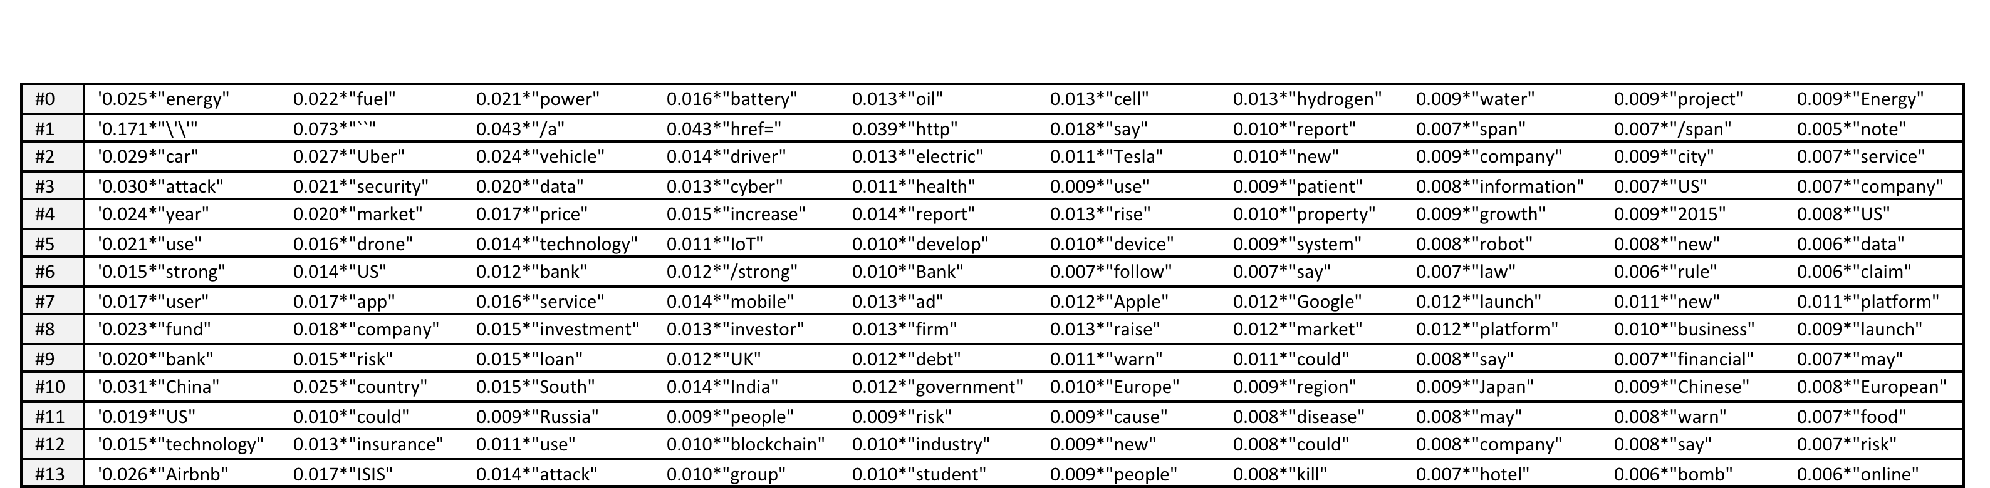
Topic modelling

Slide 9
Sample query
query = ‘Despite the notion that the 2.3 million adults living with their parents are saving money for a property, a new survey shows that 50% of millennials have less than $1,000 of savings, in addition to being burdened with student debt. Foreign money, investor dominance and high prices for properties in desirable areas are contributing to what this commentator calls “rental Armageddon,” concluding that millennials are in no position to save the housing market.’

Slide 10
Suggested topics
(13, 0.13216640717063935) 0.026*"Airbnb" + 0.017*"ISIS" + 0.014*"attack" + 0.010*"group" + 0.010*"student" + 0.009*"people" + 0.008*"kill" + 0.007*"hotel" + 0.006*"bomb" + 0.006*"online"
(4, 0.28871330951632795) 0.024*"year" + 0.020*"market" + 0.017*"price" + 0.015*"increase" + 0.014*"report" + 0.013*"rise" + 0.010*"property" + 0.009*"growth" + 0.009*"2015" + 0.008*"US"

Slide 11
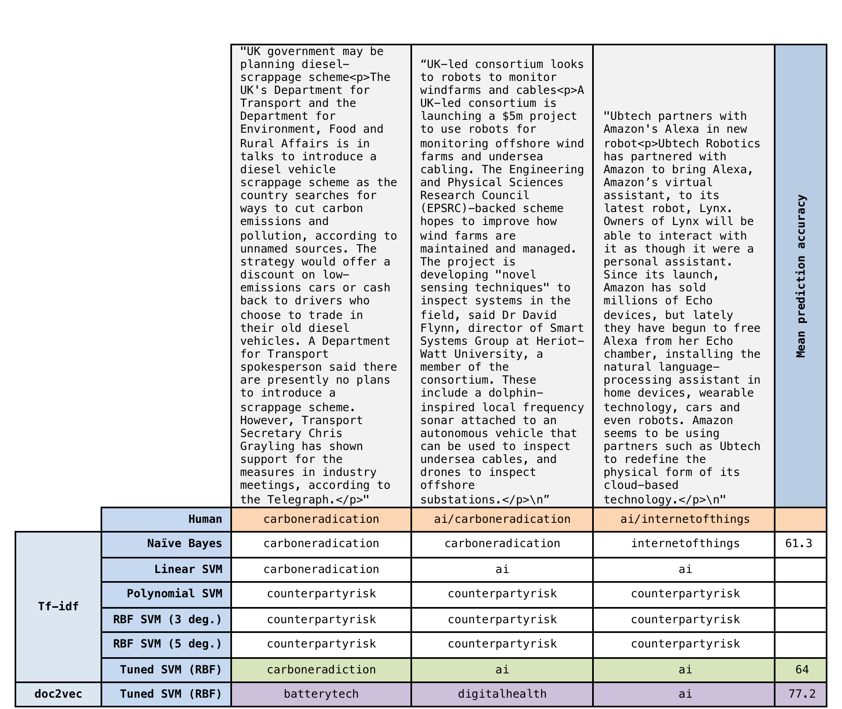
Support Vector Machines

Slide 12
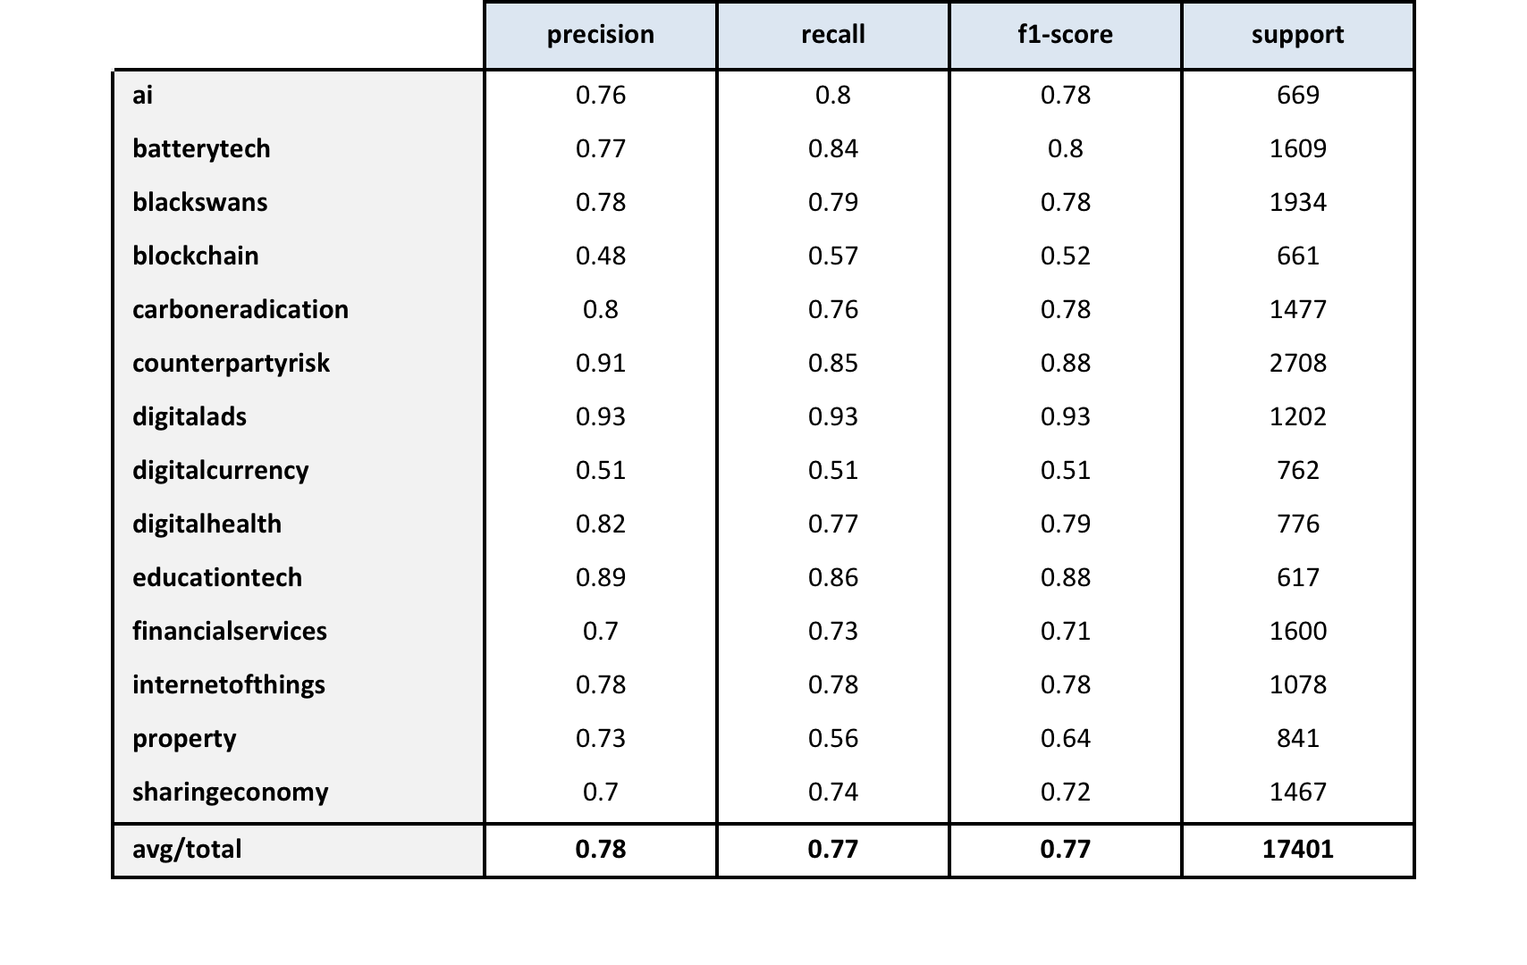
Quantified Results: Tf-idf
Notes:
Precision - Precision is the ratio of correctly predicted positive classifications to the total predicted positive classifications. The question that this metric answers is: of all articles that we labelled as belonging to a particular topic, how many actually belonged to that topic? High precision relates to a low false positive rate. We have got 0.788 precision which is pretty good. (Precision = True Positives / True Positives + False Positives)
Recall - Recall is the ratio of correctly predicted positive classifications to the overall classifications in an actual topic. The question recall answers is: Of all the articles that were truly classified (by humans) as belonging to a topic, how many did our SVM correctly label as belonging to that topic? (Recall = True Positives / True Positives + False Negatives)
F1 score - F1 Score is the weighted average of Precision and Recall (aka the harmonic mean. It therefore takes both false positives and false negatives into account, and is useful if the data has an uneven distribution of topics. (F1 score = 2*(Recall * Precision) / (Recall + Precision)
Support – Support is simply the number of truly classified samples in the original training data set for that topic.
In each case (other than Support), a score of 1 would be perfect classification of the testing sample by the SVM; while a score of 0.5 would be equivalent to classifying the articles with a coin toss.

Slide 13
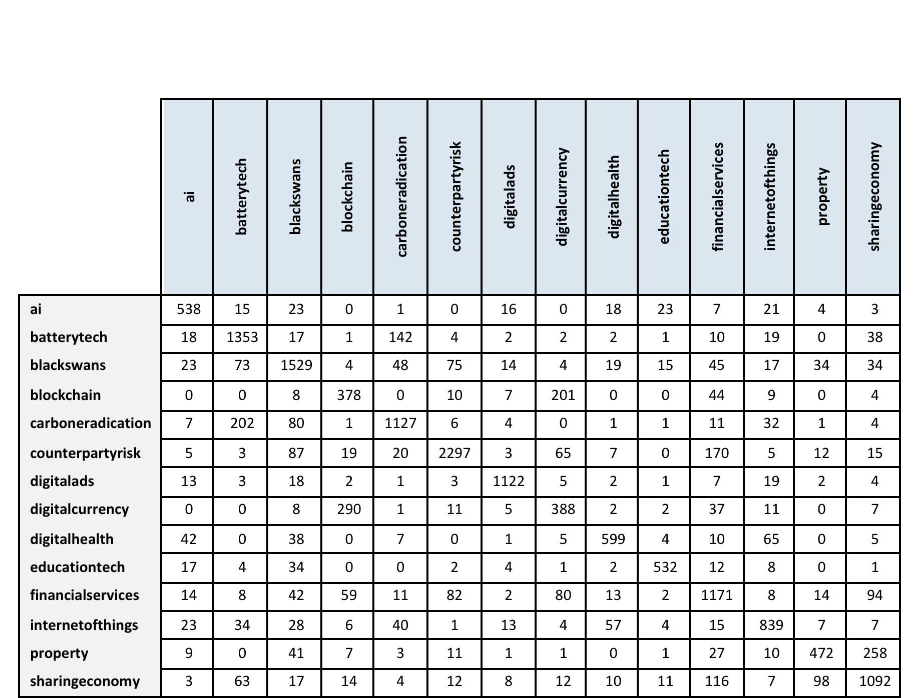
Confusion Matrix: Tf-idf
Notes:
The confusion matrix, on the other hand, shows how documents from labeled topics perform when we ask our model to predict what it things their label should be. Perfect prediction would mean each topics documents were always predicted to belong only to that topic, and so the diagonal numbers would equal the numbers of documents in each topic, and all the other numbers would be zero. Life (and semantic classification) isn’t like that, of course, and so there is a spread of misclassifications, and the matrix allows us to see the nature of that spread. This is fantastically useful from an editorial point of view, as it allows us to see the degree of crossover between what are always going to be inexact editorial categories.
We can see, for example, that there is particularly high crossover between blockchain and digital currency, between property and sharingeconony, and between batterytech and carboneradication. This is exactly what we’d expect, as we struggle with classifying articles in these sections every day (and often have to double classify them or fork them to produce two slightly different versions), and is a very good indicator that our model is working as it should.

Slide 14
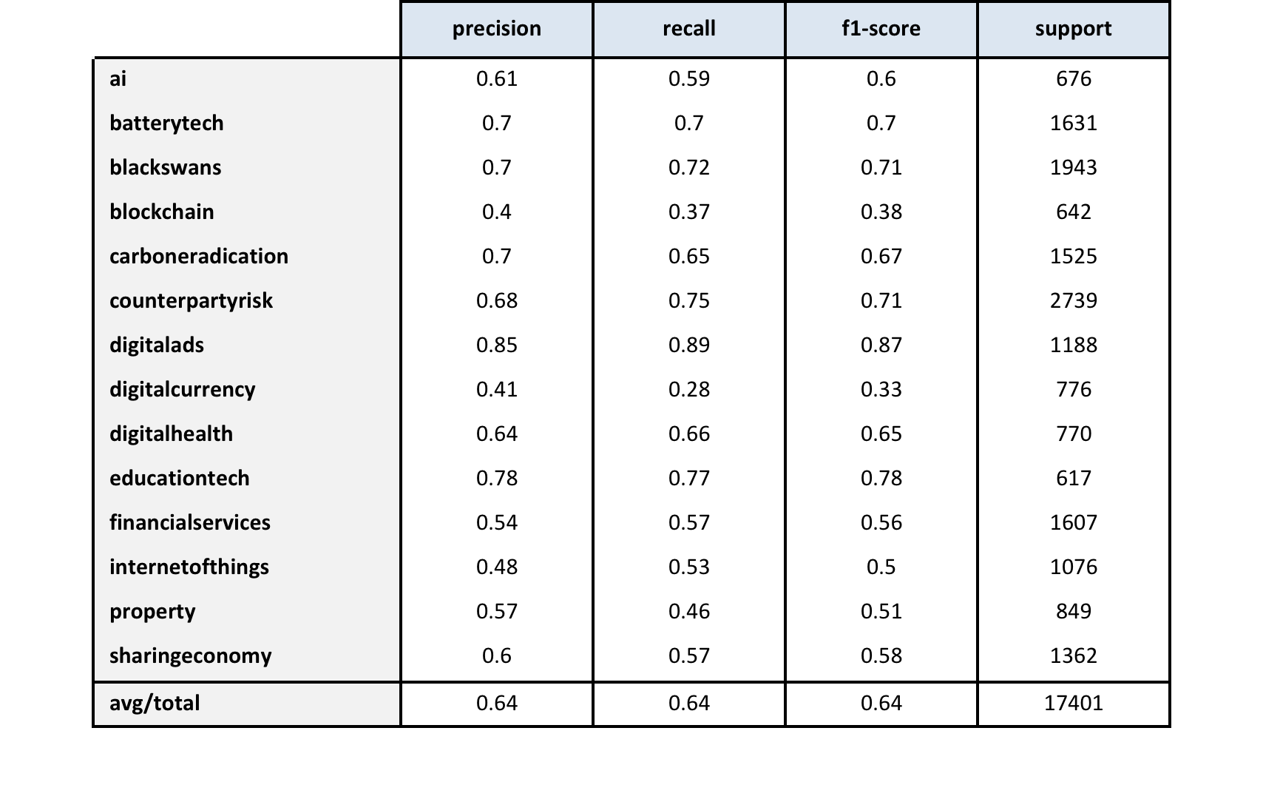
Quantified Results: doc2vec

Slide 15
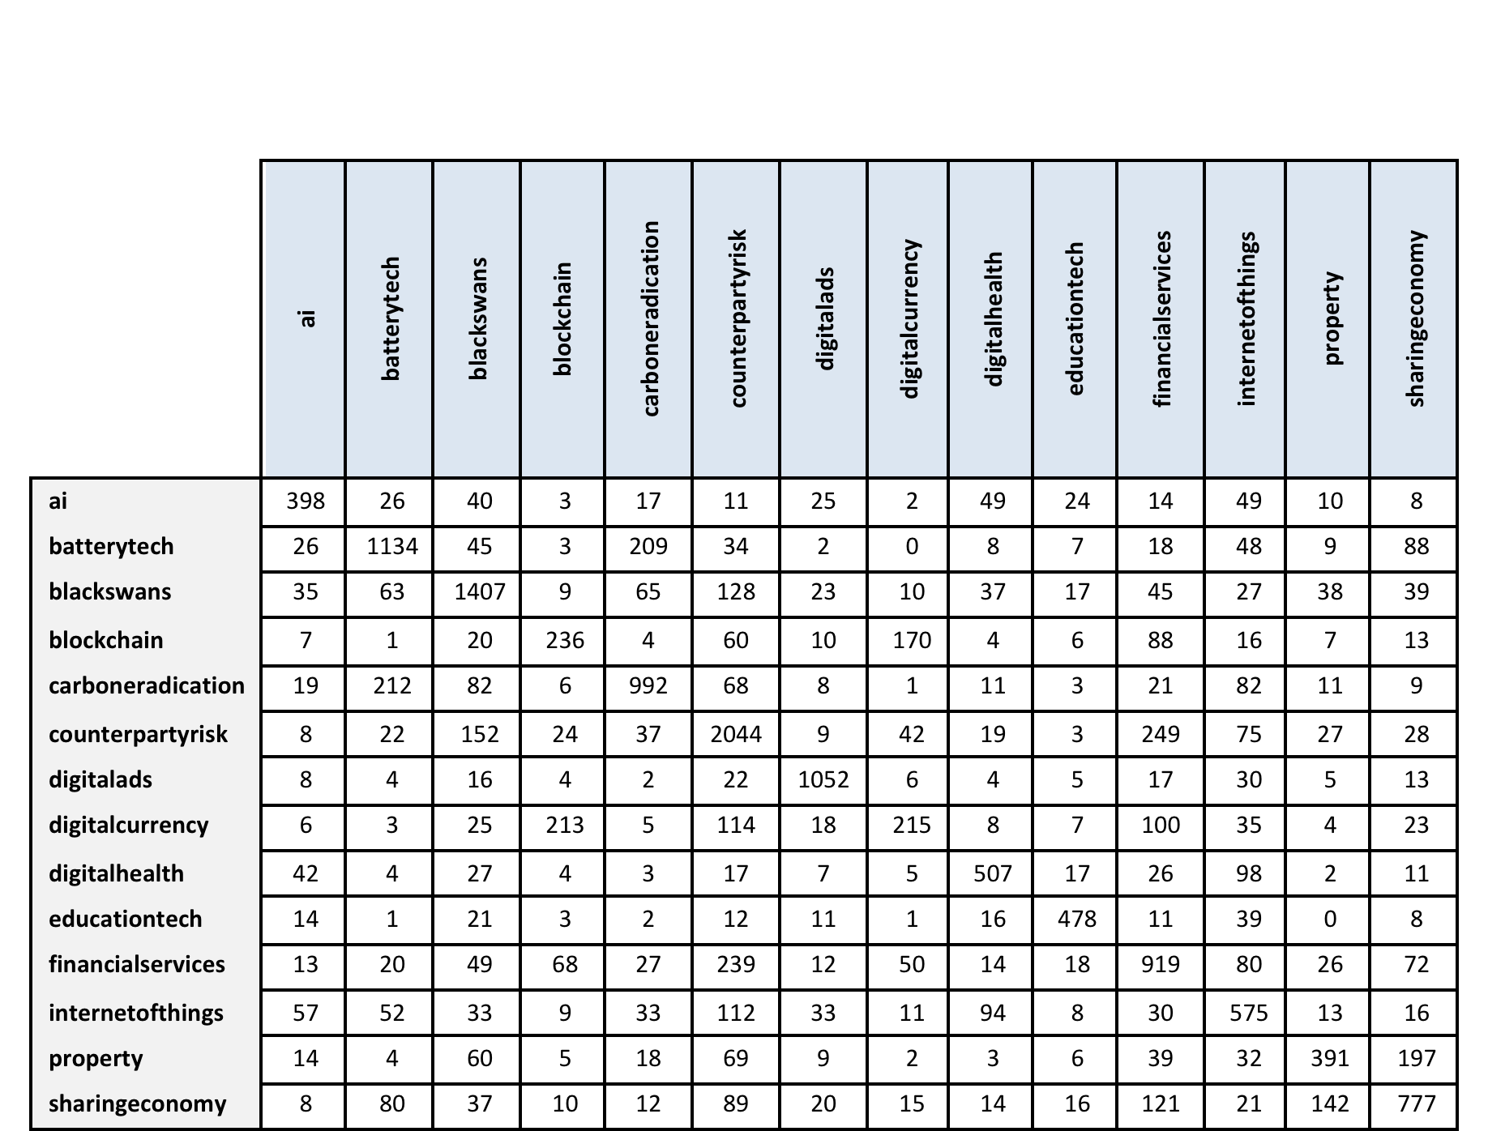
Confusion Matrix: doc2vec

Slide 16
Conclusion
The prediction accuracy of the SVM based on ti-dif averaged 0.77 as opposed to the 0.64 achieved by the SVM based on doc2vec.
The tf-idf confusion matrix scored consistently higher on the diagonal matches than did the matrix for doc2vec. Our test run on the sample of three documents suggested the better result as well (Figure 8).
Carboneradication/ai/ai was a much more accurate category result than doc2vec’s batterytech/digitalhealth/ai, which made little sense of the textual data.
➔ SVM based on tf-idf vectors is the best performer

Slide 17
Next Steps
As this SVM model can now be used to automatically classify future Curation documents without needing to hold the entire dataset in memory, we can put it online as an api-accessible web service that be queried with a new document in order to receive a suggested classification. This is something that we’ll be doing as part of our second Capstone project.
In that project we will be looking at tagging documents within topics (“microtagging”) and be looking to see if we can use a neural net to help us achieve this.
The benefit of having topics and micro tags confirmed as part of the api workflow, and feeding that confirmation back into the classification engine as a form of supervised learning, will also form part of that study.

